Slide 1
Loans Defaulter
EDA and Machine Learning Project
By Youssof Yassin

Slide 2
Problem Statement
We have Bank data that consists of loans given out to clients
The data consists of two main csvs:
Current applications made up of 307511 rows and 122 columns (features)
Previous applications from the past made up of 1670214 rows and 37 columns (features)
Our main Objective is to create a classification machine learning algorithm that will predict the TARGET variable. Going forward, we will be doing some Exploratory Data Analysis (EDA) to find out which features we will be using, performing any data cleansing needed, and choosing which new features to create.

Slide 3
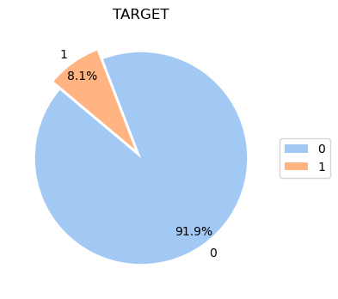
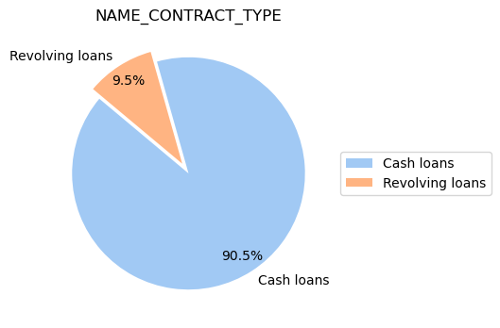
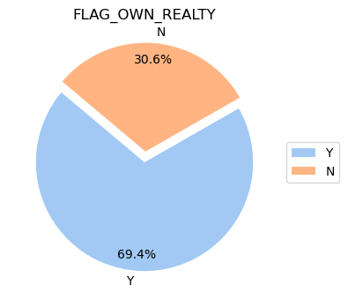
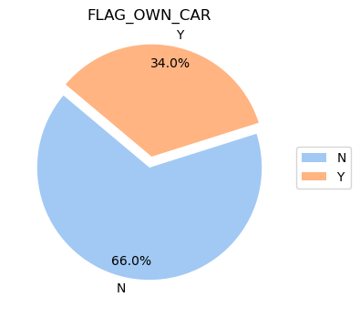

Initial Findings
On the surface, we see the following:
Almost all of the loans taken out (90.5%) are cash loans.
About 2 thirds of our clients were female.
About 2 thirds of our clients do not own a car.
About 70% do not own their place of living. In other words, they probably just rent instead.

Slide 4
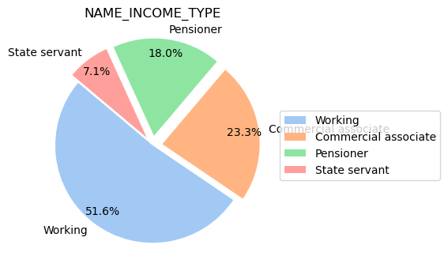
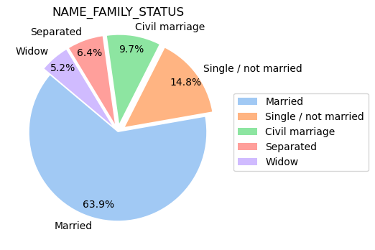
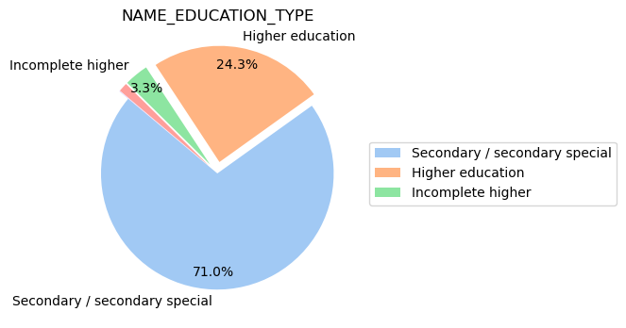
More background information
51.6% were working normally, while 23.3% were commercial associates, 18% pensioner and 7.1% as state servants
71% had only completed Secondary school, followed by 24.3% completing Higher Education and 3.3% started higher but didn't complete it.
71% had only completed Secondary school, followed by 24.3% completing Higher Education and 3.3% started higher but didn't complete it.

Slide 5
Steps to clean the data
Before we proceed to machine learning, we need to clean up the data. Specifically:
We will remove all the features that are missing at about 15-20 % of the time.
We will also remove the features previously found that were mostly one value.
grouping entries of categorical features to “others” that have too few counts.
Changing all the categories to 1s and 0s by assigning them as new features using the technique that changes them to “dummy variables”. This part is important as we machine learning algorithms only understand numbers.
We will perform similar techniques on the previous applications. After both sources of data are ready, we can join them together on the current application’s ID number to end up with one big source of data consisting of about 96 columns.

Slide 6
Machine Learning Models
3 different machine learning models were used:
Logistic Regression: The simplest to use to get the base metrics
Random Forest: Much more powerful algorithm that consists of ensembling multiple decision trees together.
XGBoost: Similar tree-based algorithm that is used a lot in Kaggle competitions for it’s speed and reliable accuracy.
We made sure to give weights to the target variable too as our data were unbalanced at a ratio of [6.19: 0.54]
After running all three, our best model was xgboost that gave us an ROC-AUC (Receiver operating characteristic - Area under the curve) score of about 0.66.
In other words, the model was only predicting the target of 0 accurately, while failing to predict the 1 class.
Finally, after implementing oversampling we managed to get an ROC-AUC score of 0.96 with the Random forest model, which is a great success!

Slide 7
Conclusion and ideas for the future
Now, we can see that safely and reliably use the final Random Forest model when predicting who will pay their loans back on time. This could potentially speed up the bank’s processes and save up on manpower and resources.
Future ideas include:
Performing more in depth exploratory data analysis, especially on previous applications
Check correlations between different features and see how they affect each other.
Check feature importance using random forest, for example. Then, remove the unimportant features, before running the machine learning algorithms again.
Trying out PCA (principal component analysis) and then clustering on the data and see if we can group up our customers in interesting and specific categories.

